Slide 1
CS5542 Big Data Analytics and App RNN & LSTM
Source: Yu Huang, Visual Detection, Recognition and Tracking with Deep Learning
Bengio, Recurrent Neural Networks (2016)

Slide 2
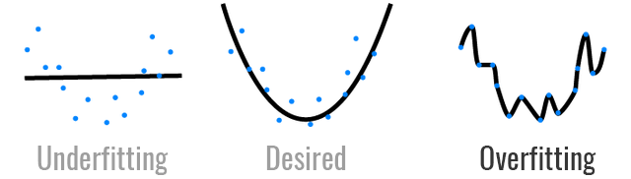
Overfitting and Underfitting
https://towardsdatascience.com/overfitting-vs-underfitting-a-conceptual-explanation-d94ee20ca7f9

Slide 3
Recurrent Neural Network

Slide 4
Motivation
Not all problems can be converted into one with fixed length inputs and outputs
Problems such as Speech Recognition or Time-series, prediction require a system to store and use context information
– Simple case: Output YES if the number of 1s is even, else NO 1000010101 – YES, 100011 – NO, …
Hard/Impossible to choose a fixed context window
– There can always be a new sample longer than anything seen

Slide 5
Recurrent Neural Network
Recurrent Neural Networks take the previous output or hidden states as inputs.
The composite input at time t has some historical information about the happenings at time T < t.
RNNs are useful as their intermediate values (state) can store information about past inputs for a time that is not fixed a priori.

Slide 6
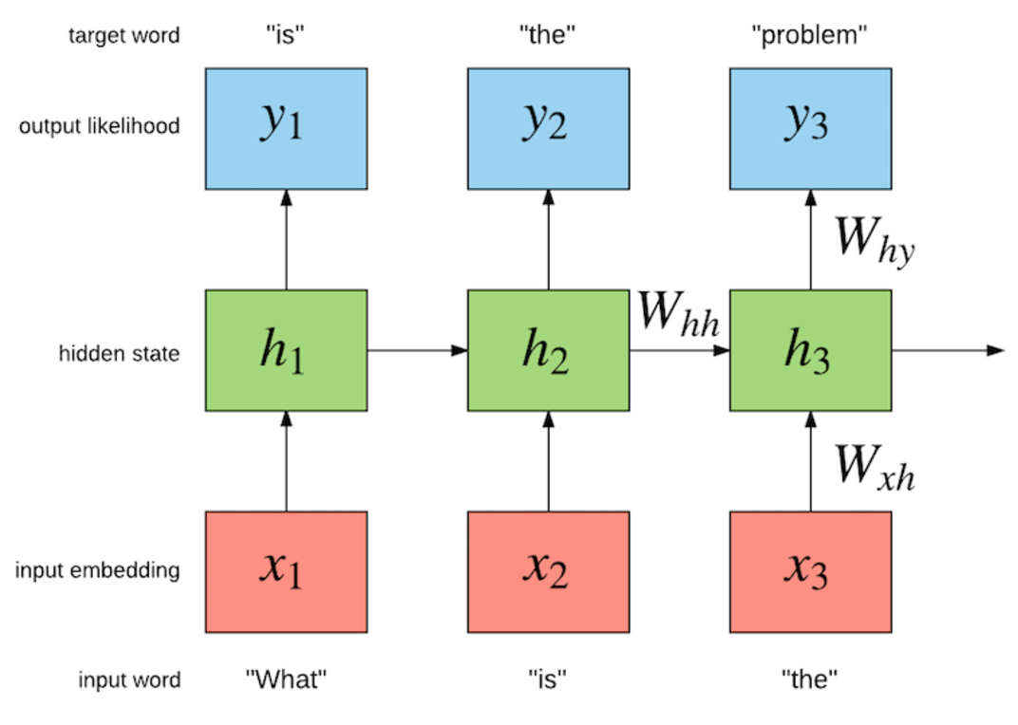
Recurrent Neural Network: Language Models
to build a language model which maximizes the likelihood of the next word given the history of previous words in the sentence.
Source: http://torch.ch/blog/2016/07/25/nce.html

Slide 7
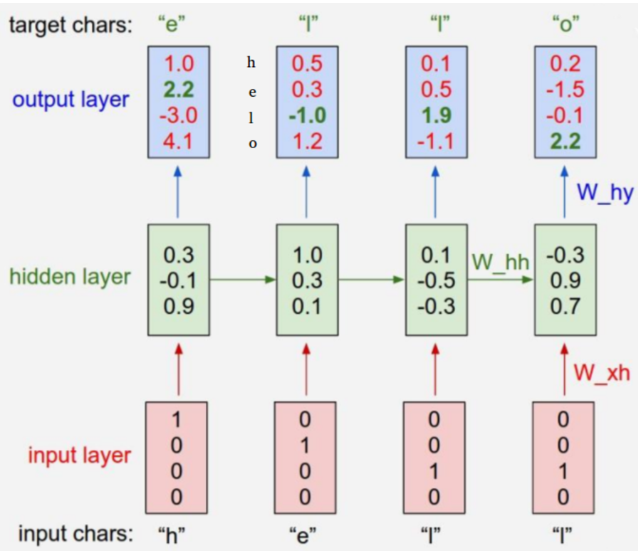
RNN: Regression Input: h,e,l,l Output: [e,l,l,o]
https://leonardoaraujosantos.gitbooks.io/artificial-inteligence/content/recurrent_neural_networks.html

Slide 8
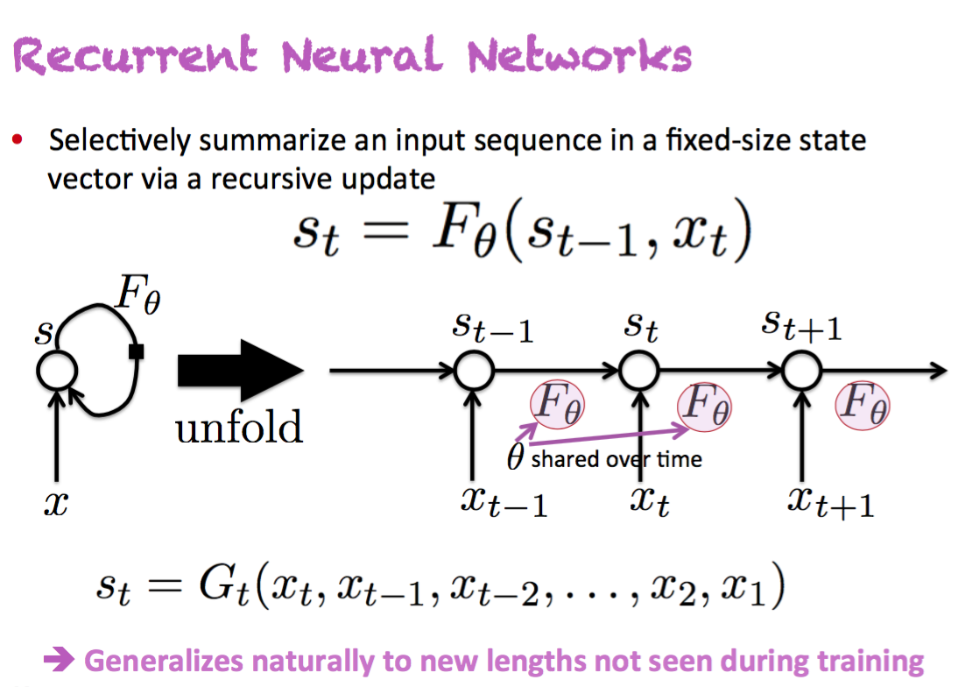
Bengio, Recurrent Neural Networks (2016)

Slide 9
RNN
Good for Sequential data, or ordered data
Internal memory: remember important things about input
Produces output, copies the output, loop it back into input
Input, forget, output gate

Slide 10
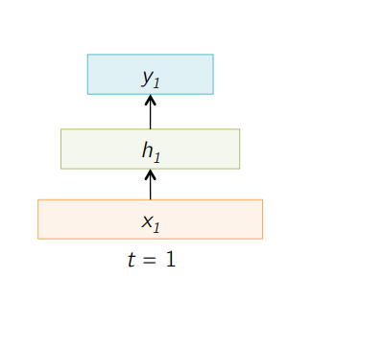
Sample Feed forward Network

Slide 11
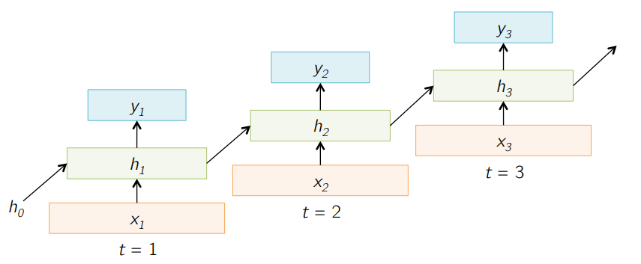
Sample RNN

Slide 12
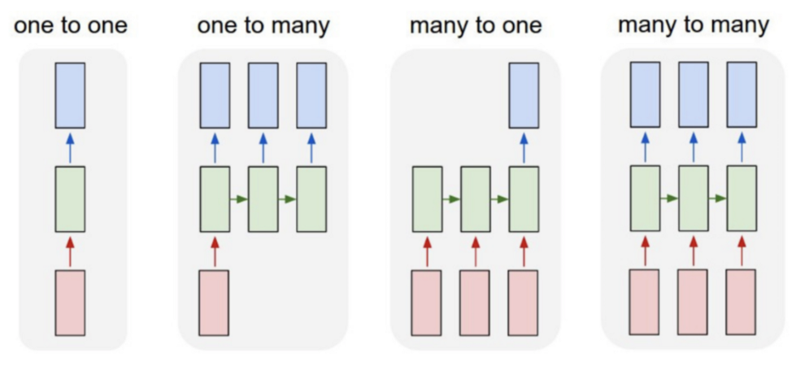
Different kind of RNN
One to many: image to many words
many to many (translation)
many to one (classifying a voice)

Slide 13
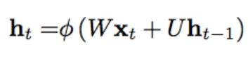
Formula of RNN
The hidden state at time step t is h_t

Slide 14
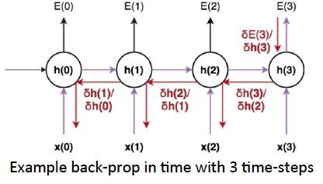
Recurrent Neural Network
Back Propagation Through Time (BPTT): The training method has to take into account the time operations → a cost function E is defined to train our RNN, and in this case the total error at the output of the network is the sum of the errors at each time-step:

Slide 15


Limitations of RNNs
Recurrent Neural Networks work just fine when we are dealing with short-term dependencies. That is when applied to problems like:
RNNs turn out to be quite effective. This is because this problem has nothing to do with the context of the statement. The RNN need not remember what was said before this, or what was its meaning, all they need to know is that in most cases the sky is blue. Thus the prediction would be:

Slide 16
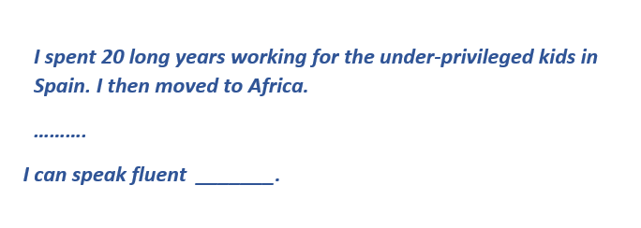
Limitations of RNNs
However, simple RNNs fail to understand the context behind an input. Something that was said long before, cannot be recalled when making predictions in the present. Let’s understand this as an example:
we can understand that since the author has worked in Spain for 20 years, it is very likely that he may possess a good command over Spanish. But, to make a proper prediction, the RNN needs to remember this context. The relevant information may be separated from the point where it is needed, by a huge load of irrelevant data. This is where a Recurrent Neural Network fails!

Slide 17
Limitations of RNNs
The reason behind this is the problem of Vanishing Gradient.
We know that for a conventional feed-forward neural network, the weight updating that is applied on a particular layer is a multiple of the learning rate, the error term from the previous layer and the input to that layer.
Thus, the error term for a particular layer is somewhere a product of all previous layers’ errors.
When dealing with activation functions like the sigmoid function, the small values of its derivatives (occurring in the error function) gets multiplied multiple times as we move towards the starting layers. As a result of this, the gradient almost vanishes as we move towards the starting layers, and it becomes difficult to train these layers

Slide 18
Problems with sigmoid function
one of the most widely used activation functions today. Then what are the problems with this?
Towards either end of the sigmoid function, the Y values tend to respond very less to changes in X
What does that mean?
The gradient at that region is going to be small
Problem of “vanishing gradients”

Slide 19
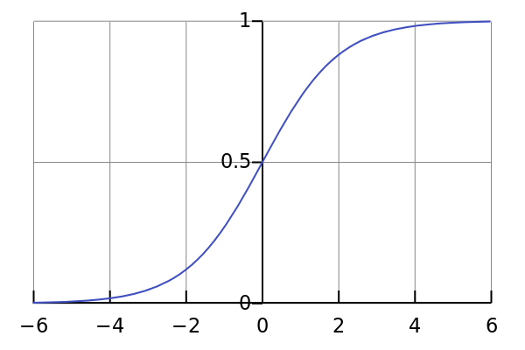
Limitations of RNNs
Sigmoid Function
3

Slide 20
Recurrent Neural Network
Main problems:
Exploding Gradients: weights assigns high importance
Vanishing Gradients: values of gradients are too small.
model stops learning

Slide 21
Improvement over RNN: LSTM (Long Short-Term Memory) Networks

Slide 22
LSTM
LSTMs on the other hand, make small modifications to the information by multiplications and additions.
With LSTMs, the information flows through a mechanism known as cell states. This way, LSTMs can selectively remember or forget things. The information at a particular cell state has three different dependencies.
The previous cell state (i.e. the information that was present in the memory after the previous time step)
The previous hidden state (i.e. this is the same as the output of the previous cell)
The input at the current time step (i.e. the new information that is being fed in at that moment)

Slide 23
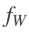
LSTM – Vanishing Gradients Problem
LSTM provides a different recurrent formula , it's more powerful than vanilla RNN,
add "residual information" to the next state instead of just transforming each state.
LSTM is the "residual" version of RNNs.
LSTM suffer much less from vanishing gradients than normal RNNs. The plus gates distribute the gradients.
LSTM are better to remember long term dependencies.
Vanishing Gradient Problem is a difficulty found in training certain Artificial Neural Networks with gradient based methods (e.g. Back Propagation). Gradient based methods learn a parameter's value by understanding how a small change in the parameter's value will affect the network's output. If a change in the parameter's value causes very small change in the network's output - the network just can't learn the parameter effectively https://www.quora.com/What-is-the-vanishing-gradient-problem

Slide 24
RNN vs. LSTM: Long short-term memory
The vanishing/exploding gradient problem.
To fix the exploding gradient problem,
Do a gradient clipping, that will allow only a maximum gradient value.
This highway for the gradients is called Cell-State, so one difference compared to
RNN has only the state flowing,
LSTM has states and the cell state (memory-based networks)

Slide 25
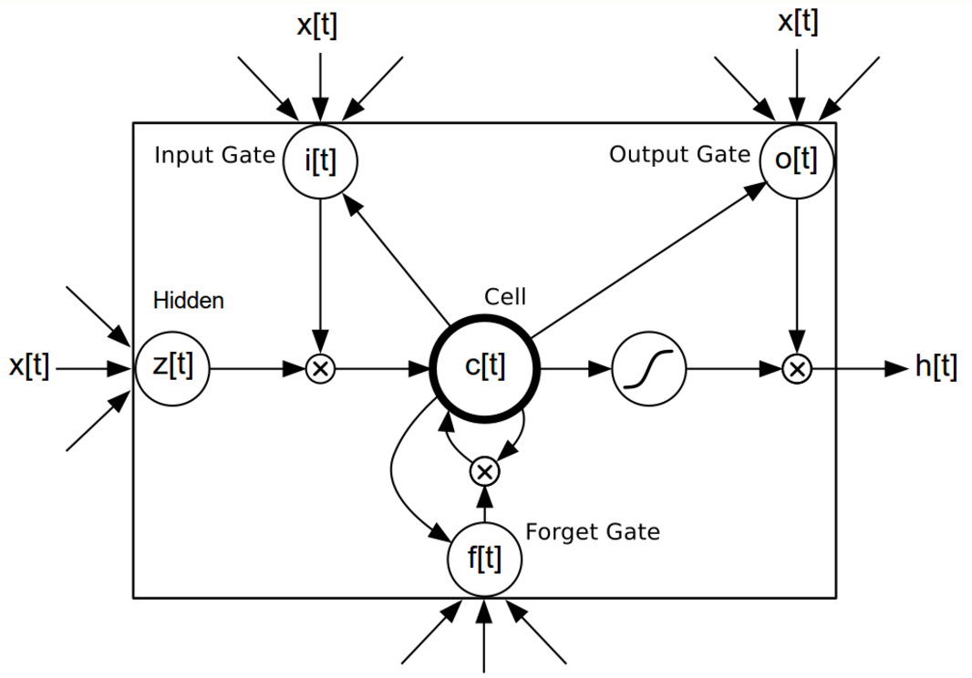
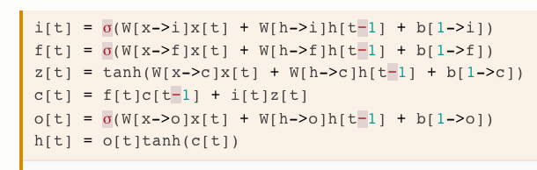
LSTM: Long short-term memory
LSTMs are recurrent networks where each neuron is replaced by a memory unit.
The unit contains an actual neuron with a recurrent self-connection.
The activations of those neurons within the memory units are the state of the LSTM network.

Slide 26
LSTM: Long short-term memory
The memory unit receives input from the other memory units.
Input Gate: computes how much of the input to forward to the actual neuron,
Forget Gate: Compute how much of the neuron’s previous activation to keep, and
Output Gate: compute how much of its activation to output.

Slide 27
LSTM: Long short-term memory
the output of a memory unit is computed by taking its state,
applying an activation function, and
multiplying the result by the output gate.
The vector of outputs from all memory units is the output of the LSTM network.
in the very related GRU network, the memory units directly output their state.

Slide 28
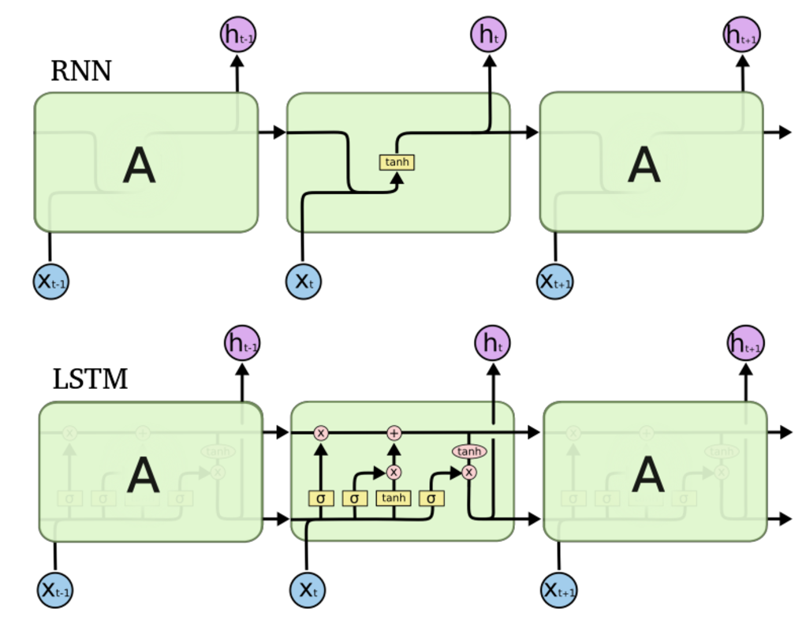
RNN vs. LSTM
https://leonardoaraujosantos.gitbooks.io/artificial-inteligence/content/recurrent_neural_networks.html

Slide 29

Long Short-Term Memory (LSTM)

Slide 30
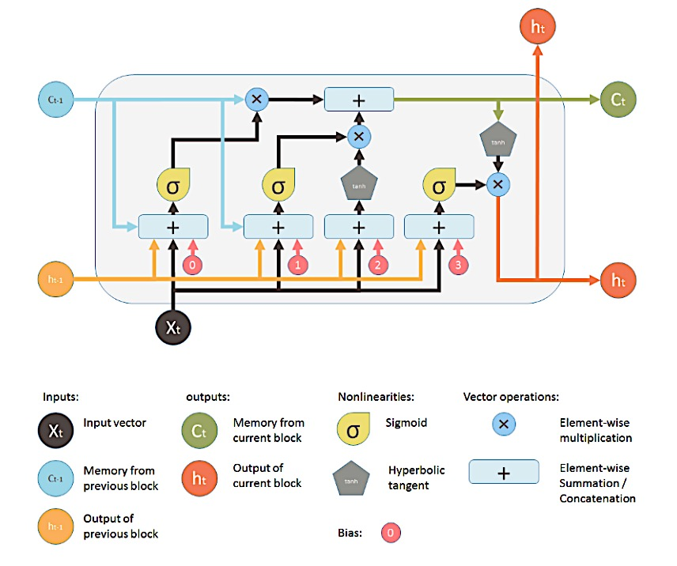
LSTM: Long short-term memory

Slide 31
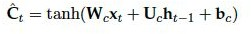
Long Short Term Memory (LSTM) cell
An LSTM cell is defined by two groups of neurons plus the cell state (memory unit):
Gates
Activation units
Cell state
Computation Flow

Slide 32
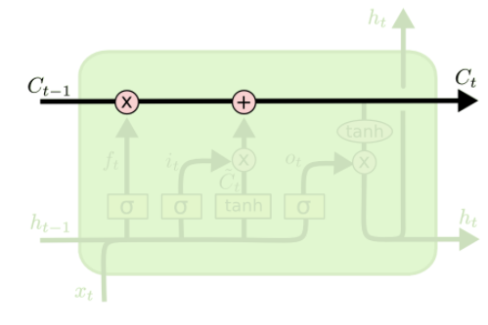
Core idea behind LSTM
key to LSTMs is the cell state
horizontal line running through the top of the diagram
have the ability to remove or add information to the cell state regulated by structures called gates

Slide 33

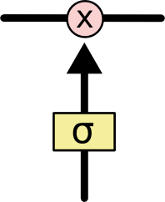
LSTM Cell
Key element of LSTM – Cell State
The ability to manipulate the information to the cell state using gates such as
Forget gate
Input gate layer
Output Layer
Note: Deep Learning Book – Ian GoodFellow uses (S_{t} ) for cell state
Gate Structure

Slide 34
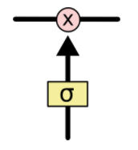
Gate
a sigmoid neural net layer and a pointwise multiplication operation
sigmoid layer outputs numbers between zero and one, describing how much of each component should be let through
An LSTM has three of these gates, to protect and control the cell state.

Slide 35
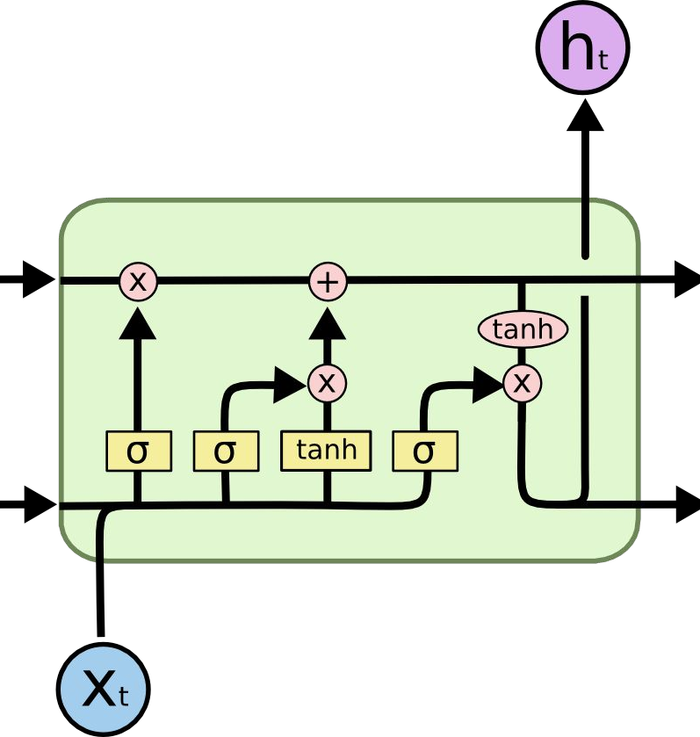
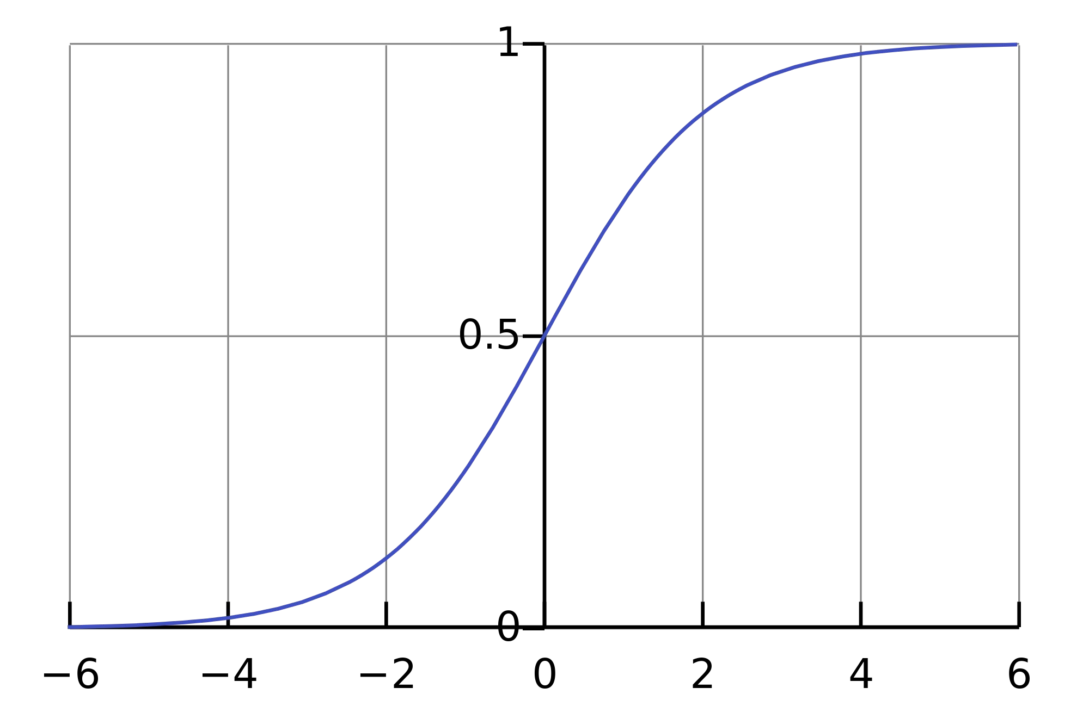

Long Short-Term Memory (LSTM)
Three gates are governed by sigmoid units (btw [0,1]) define the control of in & out information..

Slide 36
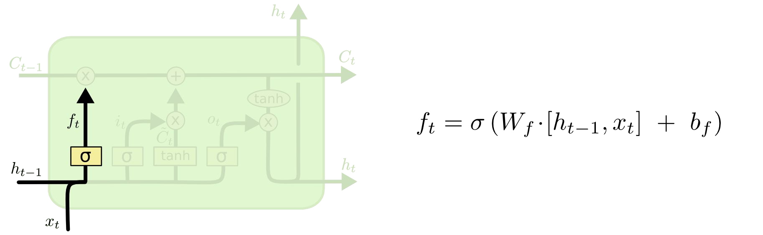

Long Short-Term Memory (LSTM)
Forget Gate
Concatenate

Slide 37

LSTM: Forget Layer
Forget Layers decides whether to retain the older information or not. (Decision is binary ie. 0 or 1)
It takes previous state info (h_{t-1}) and new input (x_{t})
e.g.. :Language Model
To ignore pronoun information from previous state. i.e. to ignore “he” “she” “it” (assuming information is not important)

Slide 38
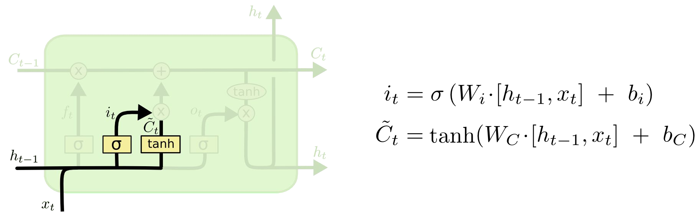
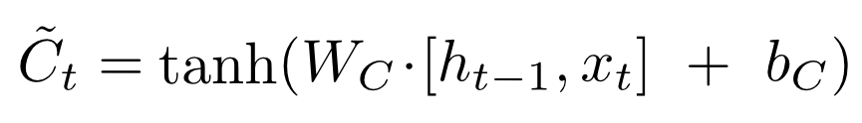
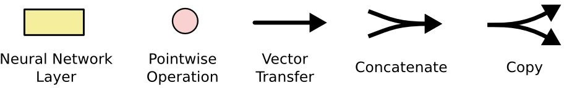
Long Short-Term Memory (LSTM)
Input Gate Layer
New contribution to cell state
Concatenate

Slide 39

LSTM: Input Gate Layer
Input Gate Layers decides which values are to be added or updated the older information or not.
C_{t}~ represents all candidate values to be added to the data
i_{t} decides if the candidate should be present or not

Slide 40

LSTM: Input Gate Layer
Input Gate Layers finally combines the C_{t}~ candidate values and their decision i_{t}
e.g.. :Language Model
To add new pronoun information from current input. i.e. to ignore “he” “she” “it”

Slide 41
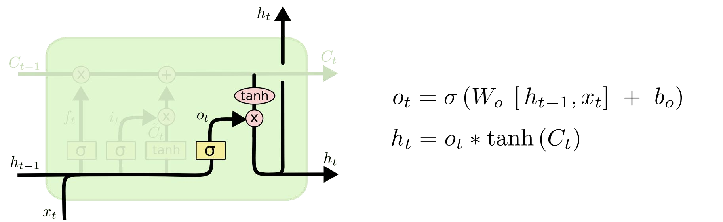
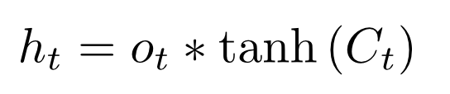
Long Short-Term Memory (LSTM)
Output Gate Layer
Output to next layer

Slide 42

LSTM: Output Gate Layer
Output Gate Layers decides what are parts of cell are going to be given as output.
h_{t} combines the decision from o_{t} and the transformed out of C_{t} with tanh
o_{t} decides if the cell value should be present or not
e.g.. :Language Model
To decide whether subject is singular or plural

Slide 43
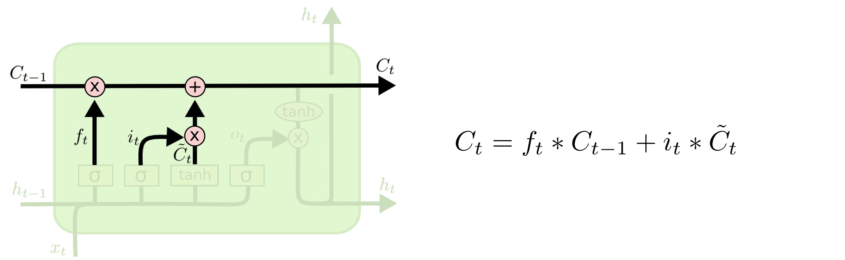
Long Short-Term Memory (LSTM)
Update Cell State (memory)

Slide 44
Applications: Text Generator
Suppose we want to train a LSTM to predict the next word using a sample short story
feed a LSTM with correct sequences from the text of 3 symbols as inputs
eventually the neural network will learn to predict the next symbol correctly

Slide 45
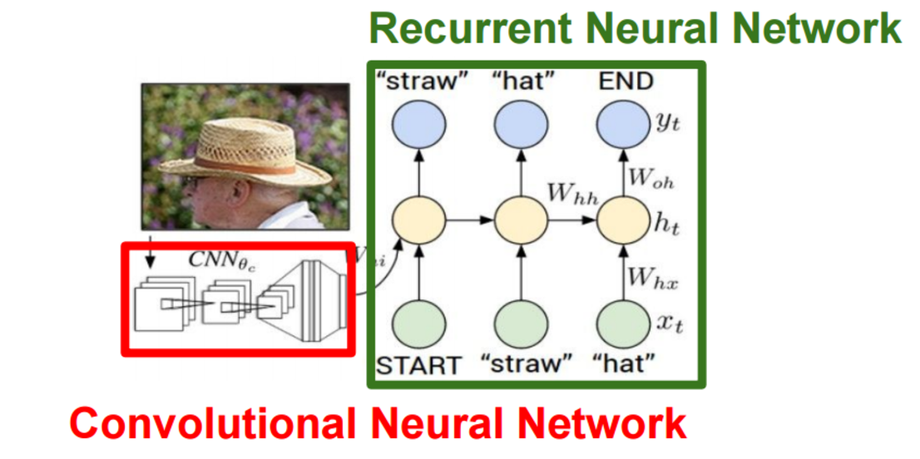
CNN+RNN: Image to Text

Slide 46
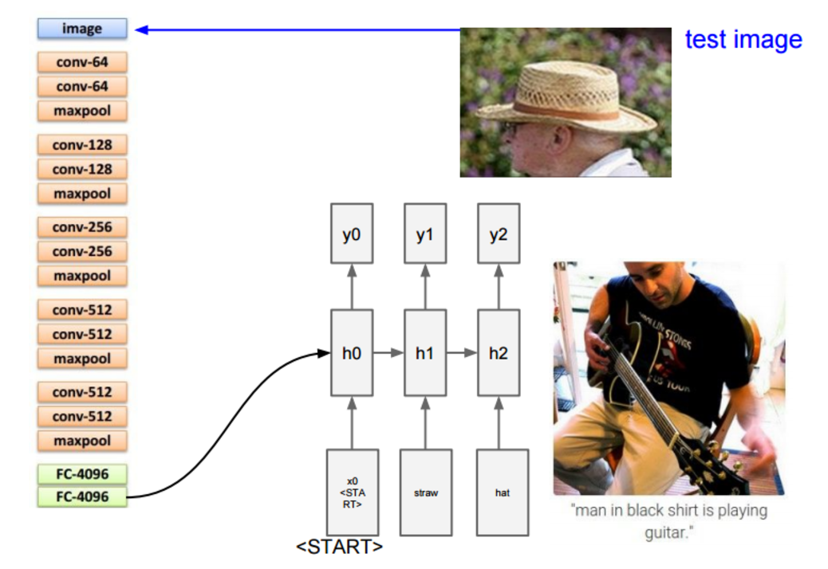
End-to-End Training: a pre-trained CNN (i.e, VGG) is connected to the second-to-last Fully Connected (FC) layer and is connected to a RNN.
https://leonardoaraujosantos.gitbooks.io/artificial-inteligence/content/recurrent_neural_networks.html

Slide 47
References
https://towardsdatascience.com/lstm-by-example-using-tensorflow-feb0c1968537
https://medium.com/@erikhallstrm/hello-world-rnn-83cd7105b767
https://towardsdatascience.com/exploring-activation-functions-for-neural-networks-73498da59b02
https://medium.com/lingvo-masino/introduction-to-recurrent-neural-network-d77a3fe2c56c
http://colah.github.io/posts/2015-08-Understanding-LSTMs/
https://www.slideshare.net/ashraybhandare/deep-learning-cnn-and-rnn?qid=0f39b4da-a290-4e9e-9d31-ed21816598e3&v=&b=&from_search=27

Slide 48
Thank You!

